Slide 1

PERSONALITY
Professional Development
18.1
Group B
SOC
11.07.2018

Slide 2
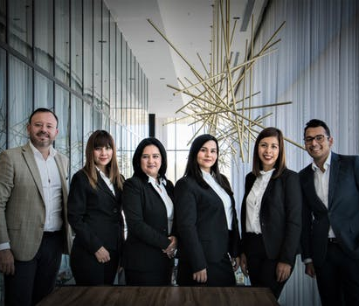
Section Header 01
PERSONALITY
Introduction
Identity is the aggregate of manners by which an individual responds and concepts with others or personality is by an large characterized as the profoundly imbued and moderately persevering examples of thought, feeling and conduct.

Slide 3
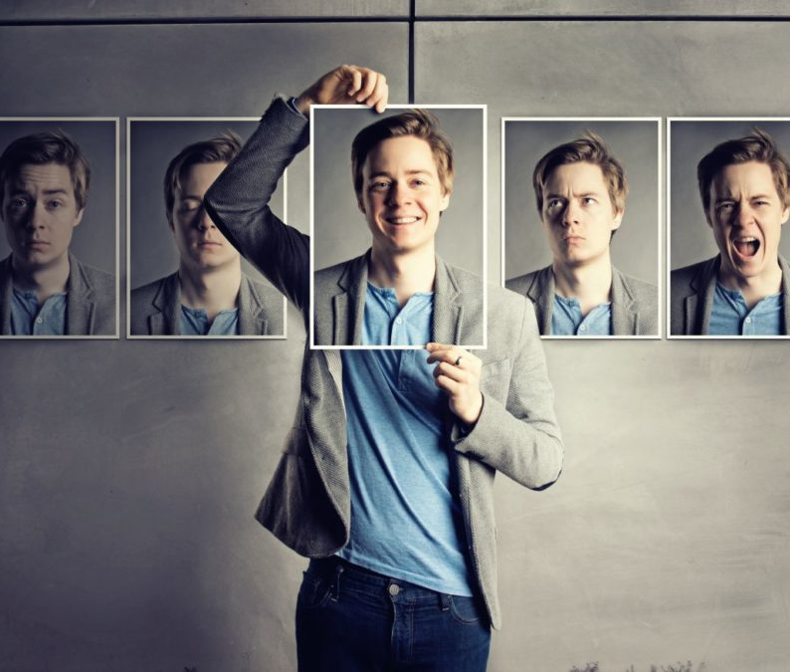
Section Header 02
PERSONALITY
Determinant
1.Heredity
2.Environment
3.Situation

Slide 4

PERSONALITY
Section Header 03
Qualities of the building positive personality
Accept responsibility
show thought
chose your words deliberately
Never Criticize, Complain & Condemn
Smile and Be kind
Put Positive understanding on other individuals’ conduct
Be a good listener
Be Enthusiastic

Slide 5

PERSONALITY
Section Header 04
Give Honest & Sincere Appreciation
When you commit an error, acknowledge it & make it simple to change
Discuss but don’t content
Don’t Gossip
Turn your guarantees into duty
Practice humility
Practice genuineness , Integrity & Sincerity
Be thankful yet don’t expect appreciation
Be reliable & hone devotion
Be understanding & carry
Don’t be mocking & put others down

Slide 6

PERSONALITY
Section Header 05
Self awareness
Self awareness knows your inspirations, inclination, identity & seeing how these variables impact your judgment, choices & connections with others individuals. Through self awareness one “builds up the capacity to know how you are feeling & why, the effect your sentiments how on your conduct. In any case, includes an ability to screen & control those solid subliminal inclinations that all us harbour & that skew our basic leadership”.

Slide 7

PERSONALITY
Section Header 06
Advantages of self awareness
Understanding yourself in connection to others
Developing & actualizing a sound self-change program
Setting proper life & vocation objectives
Developing associations with others
Understand the estimation of assorted variety
Managing others adequately
Increasing efficiency
Increasing your capacity to add to Organizations, your locale & family

Slide 8
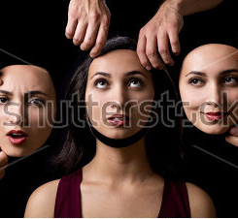
PERSONALITY
Section Header 07
Attitudes
Attitudes are evaluative proclamations or scholarly pre-mines to a react to a question, individual or a thought in a positive or troublesome way. Mentalities are thin in scope. They can fluctuate from circumstance. Solid mentalities can affect proficient & individual relationship .Our state of mind can decide if we think decidedly & take control of a circumstance or think adversely and feel defenceless to change or react a circumstance. Our mentality is a vital part of our capacity to be profitable at work. Our demeanours can impact individuals around us. Monitoring our own states of mind & setting on decisions about which disposition to show to others is essential to us as people or as supervisors.

Slide 9
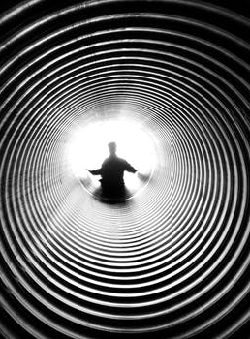
PERSONALITY
Section Header 08
Behaviour
Conduct is simply the by which we can the manner by which we act .Our conducts is affected by our emotions, judgments, convictions, inspirations, needs, experience and feeling of others. Examples of conduct create through our responses to occasions and actitives over some over some undefined time frame. Conduct comprise of four segment. For example,
Motivation
Modes of reasoning
Modes of acting
Modes of communicating

Slide 10
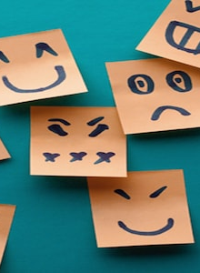
PERSONALITY
Section Header 09
Dimensions of personality
This Big Five identity qualities, otherwise called the five factor demonstrate is a model in light of basic dialect descriptors of identity(Lexical speculation).These descriptors are gathered together utilizing a measurable system called factor investigation(i.e. this model did not depend on logical investigations). This generally inspected hypothesis proposes five expansive measurements utilized by a few clinicians to portray the human identity & mind

Slide 11

PERSONALITY
Section Header 10
Dimensions of personality | High level | Low level
Openness to experience | Inventive, Curious | Cautious, Conservative
Conscientiousness | Efficient, Organized | Easy going, Careless
Extraversion | Outgoing, Energetic | Solitary, Reserved
Agreeableness | Friendly, Compassionate | Competitive, Outspoken
Neuroticism | Sensitve, Nervous | Secure, Confident

Slide 12

THANK YOU

